Slide 1
Sentiment Analysis on Food Reviews
By: Amir Ali & Stanisław Matuszewski & Jacek Czupyt

Slide 2
Outline
Introduction & Problem Statement
Related Work
Data Collection
Data Processing
Exploratory Data Analysis
System Architecture
Conclusion

Slide 3
Introduction & Problem Statement
The objective of the project is to use NLP methods to extract the overall sentiment of a piece of text, specifically a food review, in order to discern whether it is very negative, negative, neutral, positive, very positive.
The developed model can later be used to quickly and effectively estimate the sentiment of unlabeled comments.

Slide 4

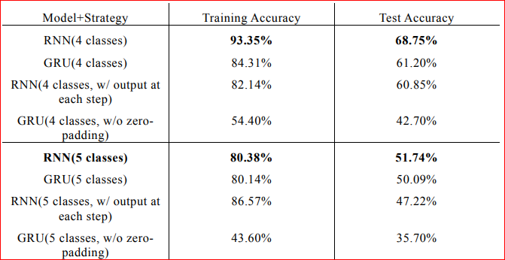
Related Works
1.
Accuracies for different models on Amazon Fine Food Reviews dataset

Slide 5
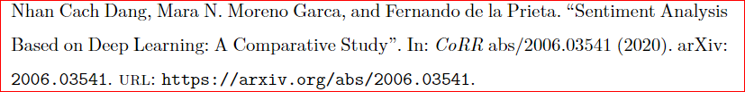
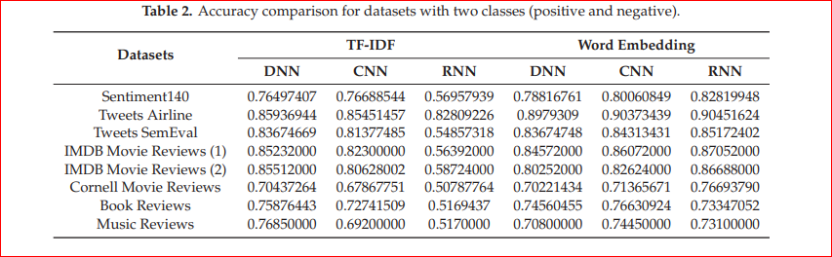
Related Works
2.

Slide 6
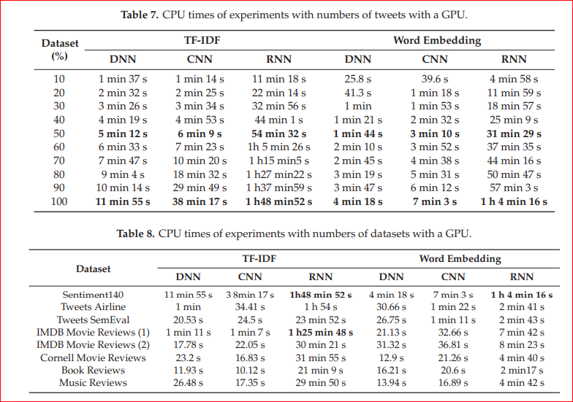
Related Works
2.

Slide 7
Data Collection
We plan to use the following datasets for this project:
Amazon Fine Food Reviews - a dataset which contains over 500k reviews of fine foods from amazon
Our user reviews dataset from the previous project - over 12k food recipe reviews acquired from the website TasteOfHome

Slide 8
Data Processing
Text Cleaning
Lowercase
Remove Punctuation
Remove Special Words
Preprocessing Operations
Tokenization
Removing Stop Words
Lemmatization
Feature Extraction
Bag of Word Model
TF-IDF Model
Word2vec

Slide 9
Exploratory Data Analysis
Distribution of tokens in each sentence
Distribution of words in each sentence
Distribution of sentiment for each class
WordCloud for each specific class

Slide 10
System Architecture
Support Vector Machine
Multilayer Perceptrons
Random Forest
Decision Tree
RNN
LSTM
CNN
Transformer
Bert Model
fastText

Slide 11
Conclusion
In this project, we will performed sentiment analysis on a dataset of food reviews, using a variety of different machine learning models and feature engineering techniques.
We aimed to understand the sentiment of the reviews across five specific classes (e.g. extreme negative, negative, neutral, positive, extreme positive).

Slide 12
Thank you for your attention!

